Slide 1
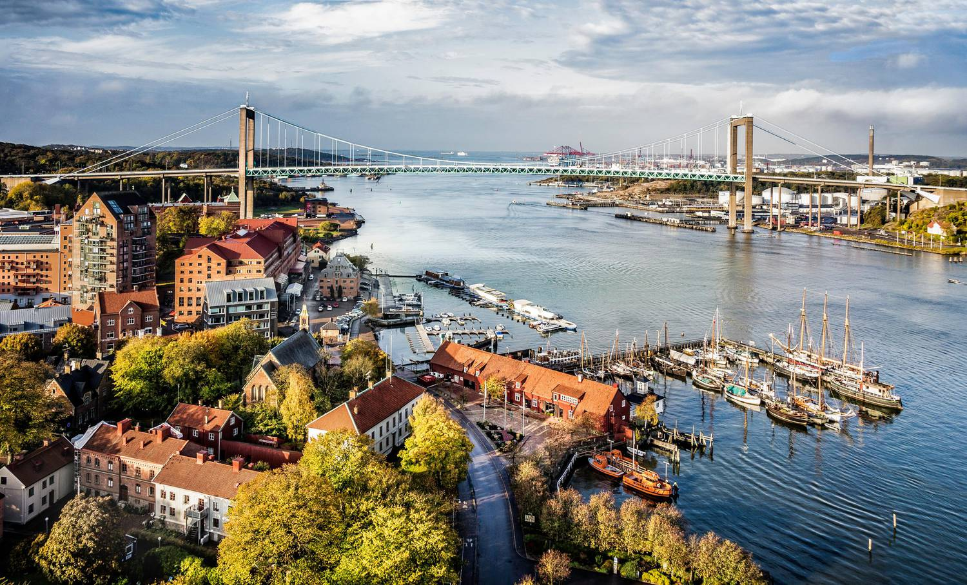
MLT MAZE GAME
Course project LT2216
Klara Båstedt

Slide 2
The game: what does it do?
An MLT student, who is new in town, tries to find their way to a bar on Andra Långgatan.
A series of desicions lets the student choose between different routes.
Some routes are better than others ☺
Three winning routes: gold, silver and bronze medal.
Three routes result in game over.
Basic Göteborg knowledge helps! New citizen will learn a few things by playing the game.

Slide 3
Technicalities
React + xstate + Webspeech API
Rasa on Heroku

Slide 4
Challenges
Rasa doesn’t like numbers… I decided to check if ”1” or “6” was in recResult instead.
Different prompts depending on the previous state wouldn’t work when the question was repeated (history state). Solved with null events.
Swedish words would not show up in the recResults (obviously). I designed the questions differently so the expected answers would be ”Go down the stairs”/”Go towards Poseidon” instead of ”Go to Korsvägen”/”Go to Götaplatsen”.

Slide 5
Relation to course contents
Previous labs with xstate and React were the most useful.
Design questions so you know what answers to expect.

Slide 6
Future work
I would like the game to be bigger and include more options!
Implement more feedback.
Include less instructions when the player plays many times.

Slide 7
Let’s play!

